Slide 1

INTRODUCTION TO NANOMATERIALS
Dr. Manoranjan Kar
Associate Professor
Department of Physics
Indian Institute of Technology Patna,
Patna- 800013, INDIA
mano@iitp.ac.in, +91-612-2552013
http://www.iitp.ac.in

Slide 2
Topics to be Covered
Introduction: Overview of Nanotechnology, Quantum effect, Naotechnology in nature.
Properties: Physical, Chemical and biological properties of nanomaterials, Effects on structure, ionization potential, melting point, and heat capacity Electronic structure at nanoscale, Magnetism at Nanoscale.
Metal and Semiconductor Nanoparticles: Surface Plasmon Resonance, Theory, Stability of metal particles, metamaterials, Nanowires and Nanotubes, Semiconductor Nanopaticles.
Synthesis of Nanomaterials: Chemical, Physical, Biological and hybrid Methods of synthesis, Assembly. Carbon Nanotubes, Lithographic methods, Scanning Probe Microscopic Methods, Physical and Chemical Vapor Deposition Methods. MEMS fabrication technique.
Nanotribology and Nanomechanics: Micro/Nanotribology and Materials Characterization Studies using Scanning Probe Microscopy, Surface Forces and Nanorheology of Molecularly Thin Films, Scanning Probe Studies of Nanoscale Adhesion Between Solids in the Presence of Liquids and Monolayer Films, Friction and Wear on the Atomic Scale, Nanoscale Mechanical Properties, Nanomechanical Properties of Solid Surfaces and Thin Films, Mechanics of Biological Nanotechnology, Mechanical Properties of Nanostructures, Micro/Nanotribology of MEMS/NEMS Materials and Devices.
Applications of Nanomaterials: Materials, Sensors and Actuators, Catalysis Medical Applications, Advanced Electronic Materials and Novel Devices. MEMS/NEMS Devices and Applications, Current Challenges and Future Trends.
Text Books:
Introduction to Nanotechnology; Charles P. Poole, Jr. and Frank J. Owens, Wiley – Interscience, 2003.
Introduction to Nanoscience; Gabor L. Hornyak, Joydeep Dutta, Harry F. Tibbals, A. K. Rao, CRC Press, Taylor and Francis Group, 2008.

Slide 3

Dr. Manoranjan Kar (mano@iitp.ac.in), Indian Institute of Technology Patna, www.iitp.ac.in
BRIEF INTRODUCTION TO PHYSICS FORMULATION

Slide 4
Dr. Manoranjan Kar (mano@iitp.ac.in), Indian Institute of Technology Patna, www.iitp.ac.in
WHAT IS MATHEMATICS?
WHAT IS CHEMISTRY?
WHAT IS PHYSICS?
WHAT IS BIOLOGY?
ARE WE CERTISFY WITH OUR ANSWER? IF YES, HOW TO PASS THE MESSAGE TO OTHERS ?
“para-upkar Swargaya... Narkaya Parapidakam”
LET US PUT OURSELVES A QUESTION NOW....
WHAT IS SCIENCE?
WHAT IS ITS TRANSLATION IN HINDI ?
“SANKHYAN”....... WHAT IS THEN “GYAN” AND “BIGYAN”
Where Engineers and Doctors stand?
Are they part of science?
Why these words are sounds very good and catchy also?

Slide 5
Dr. Manoranjan Kar (mano@iitp.ac.in), Indian Institute of Technology Patna, www.iitp.ac.in
Fundamental Units: There are accepted and non accepted unit systems
Example: Accepted: CGS, MKS, FPS etc
Not accepted: Local units: Bigha, Chain, Ana, Gauni, Tula etc.
The accepted unit is SI (Standard International Unit)
Length, Mass, Time, Electric current, Temperature, Luminous intensity, Amount of substance
Meter(m), Kilogram (kg), Second(s), Ampere(A), Kelvin (K), Candela (Cd), Mole (n)
Physical Quantities: Distinction
SCALAR: A physical quantity called a scalar which has only magnitude. In other words a physical quantity which can completely specified by a number
VECTOR: A physical quantity called a vector which has both magnitude and direction
and, it should obey the vector translation property.
Addition of two vectors:
Multiplication by a scalar
Unit vector
4. Null vector
5. Right handed co-ordinate system
6. Components of a vector

Slide 6
Dr. Manoranjan Kar (mano@iitp.ac.in), Indian Institute of Technology Patna, www.iitp.ac.in
ARE WE READY TO ANSWER ALL THE QUESTION i.e.
CAN WE DISTINGUISH ALL THE PHYSICAL QUANTITIES?
CURRENT, TIME, 5Kg POTATO IN X-AXIS, AND SO ON....
WHAT ARE THESE QUANTITIES?????
SCALAR OR VECTOR????
LET US HAVE ANOTHER DEFINITION.....
PSEUDO VECTOR/ PSEUDO SCALAR: A physical quantity which has both magnitude and direction, but does not follow the vector transformation rule.
This has put us to think what is formulation and how it differ from physics and, how to learn it?
LET US HAVE A FEW PRACTICAL EXAMPLES: WHAT IS THE COLOUR OF BIRD?????
LET US THINK: Geocentric law .....

Slide 7
Dr. Manoranjan Kar (mano@iitp.ac.in), Indian Institute of Technology Patna, www.iitp.ac.in
So what is then physics, its mathematics or something else
CAN WE REPRESENT THE PHYSICAL QUANTITY IN ANY OTHER WAY ????
FOR EXAMPLE: MATRIX
THINK ANY OTHER WAY, IT COMPEL US TO THINK WHAT IS PHYSICS

Slide 8
Dr. Manoranjan Kar (mano@iitp.ac.in), Indian Institute of Technology Patna, www.iitp.ac.in
FORMULATION IN PHYSICS
Classical Mechanics
M, v
M
0
Quantum Mechanics
M, v
v
0
c
Statistical Mechanics
M, v
Special Theory of Relativity
M, c
c
There are four fundamental forces
1: Strong Forces which holds protons and neutrons together in the atomic nucleus. More than 100 times stronger than electric forces.
2: Electromagnetic force : The name electro-magnet comes as electricity generates magnetic field but vice versa is not true.
3: The weak forces which account for certain kinds of radioactive decay. They are not only of short range but they are far weaker than electromagnetic ones to begin with.
4: Gravitational force between any two bodies having mass (M)

Slide 9
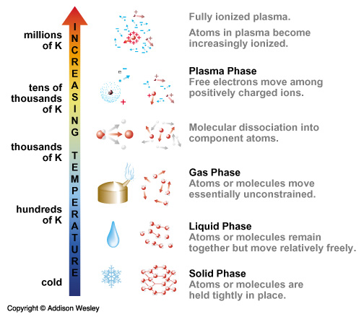
Dr. Manoranjan Kar (mano@iitp.ac.in), Indian Institute of Technology Patna, www.iitp.ac.in

Slide 10
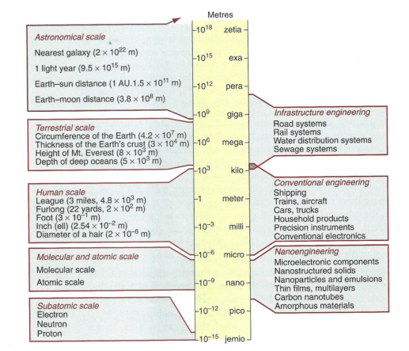
Where the scientist, engineers… stands???
Why not any engineering beyond this point ?

Slide 11
REFERENCES
Introduction to Nanotechnology; Charles P. Poole, Jr. and Frank J. Owens, Wiley – Interscience, 2003.
Introduction to Nanoscience; Gabor L. Hornyak, Joydeep Dutta, Harry F. Tibbals, A. K. Rao, CRC Press, Taylor and Francis Group, 2008.
Nanomaterials, Nanotecnologies and Design: An introduction for Engineers and Architect, M. F. Ashby, Paulo J. Ferreira, D. L. Schodek, Elsevier, 2009.
Introductory Nanoscience: Physical and Chemical Concept, Masaru Kuno, Garland Science, 2011.

Slide 12
Review of previous class
PHYSICS
Nanotechnology in upward motion: next future of science and technology is nanotechnology

Slide 13
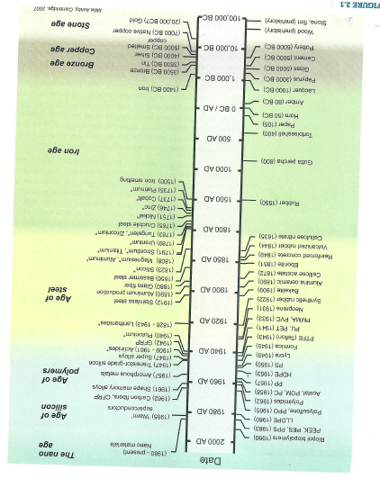

Slide 14
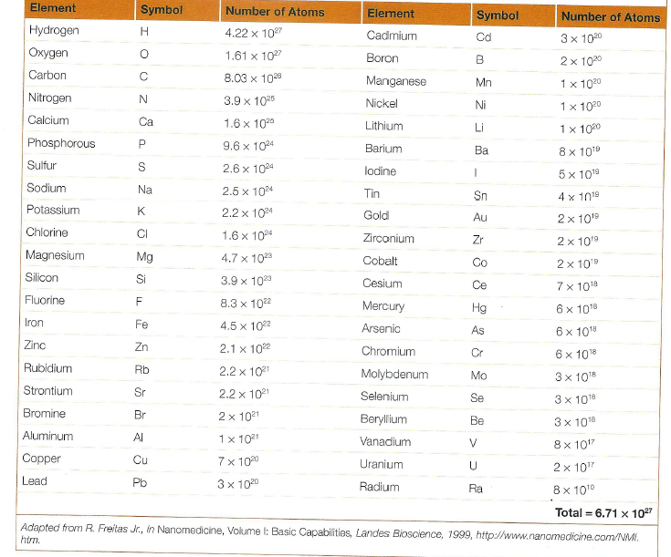
Approximate chemical composition of a 70Kg Human Body

Slide 15
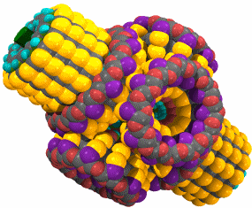
The most disruptive future changes may occur as a result of molecular manufacturing, an advanced form of nanotechnology.

Slide 16

But if the future really will be so different from today, why doesn’t it look that way from here?

Slide 17

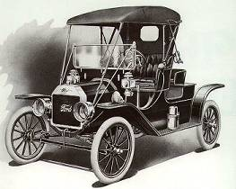
1885:
No such thing as automobiles or airplanes.

Slide 18
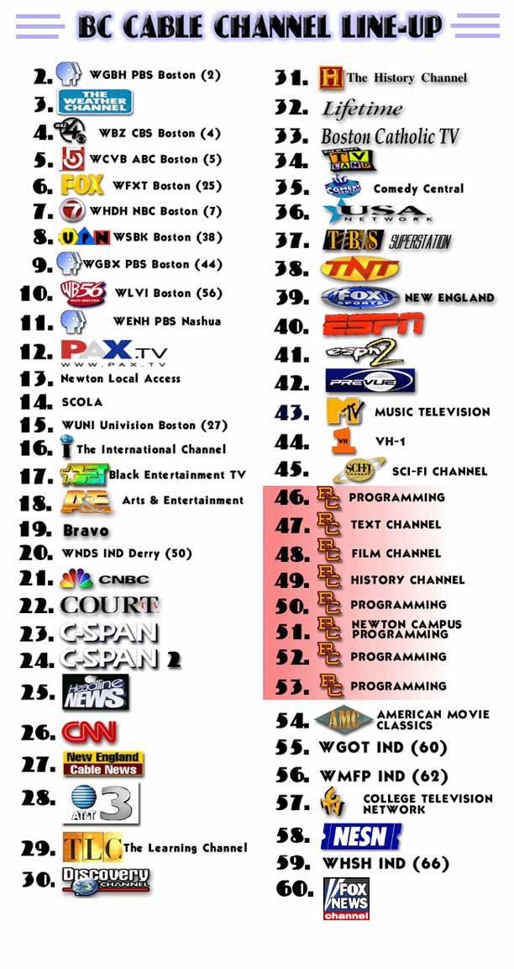
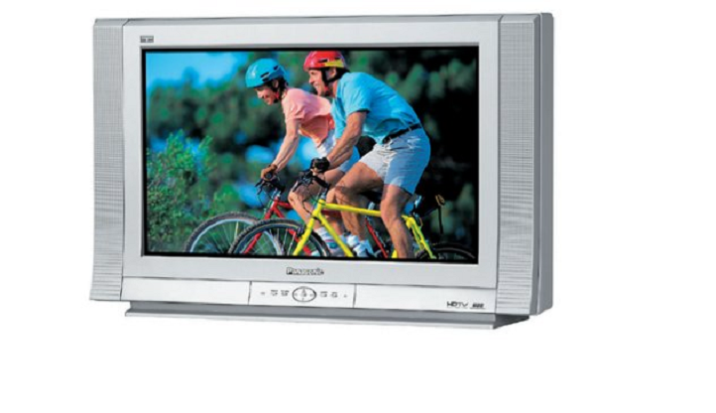
1926
1926:
No such thing as television or cable.

Slide 19
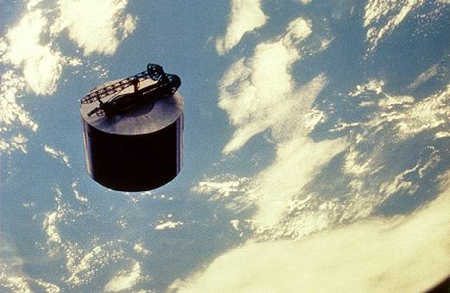
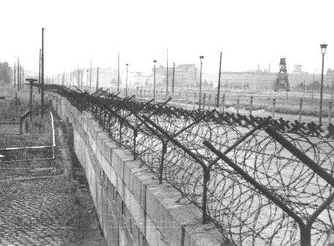
1957:
No such thing as communications, satellites etc.

Slide 20

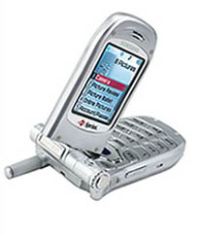
1967:
No such thing as desktop computers or cell phones.

Slide 21
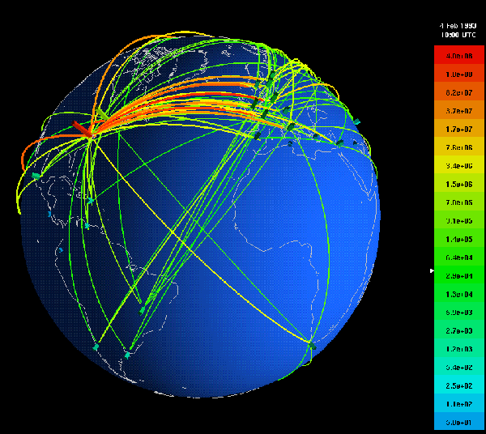
No such thing as the World Wide Web.
1986:

Slide 22
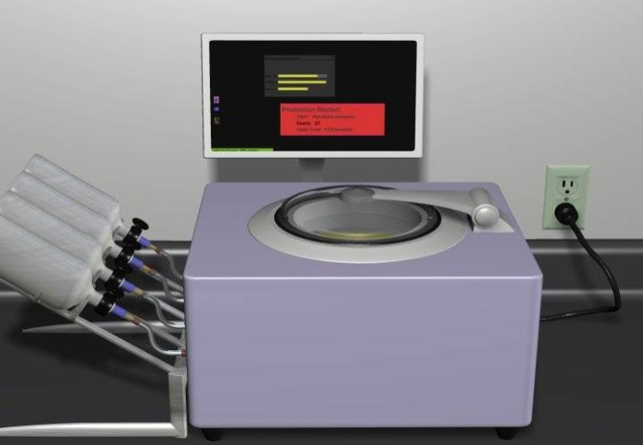
2020
No such thing as molecular manufacturing.

Slide 23
BIG STEPS in Economic, Social, and Political History
Computers
Automobiles
Change
Railways
Steam Engines
Time

Slide 24
The Next Big Step
Nanotechnology
Computers
Societal
Impacts
Automobiles
Railways
Steam Engines
(Middle Ages)
Time

Slide 25
The Next Giant/Colossal Step
Nanotechnology
Computers
Societal
Impacts
Automobiles
Railways
Steam Engines
(Middle Ages)
Time

Slide 26
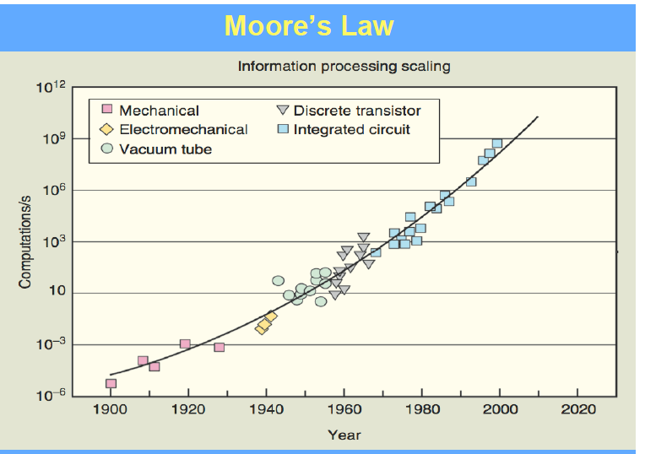
IBM

Slide 27
Questions?
Are molecular entities stable?
Are quantum effects an obstacle to atomic manipulation?
Is Brownian motion is significant effect in nanocomponents?
Are friction and wear relevant for nanocomponents?

Slide 28
What then is the Nanoscale?
Nanoscience? Nanotechnology?
Nanometer = One-billionth of a meter (10⁻⁹ m)
Nanoscale = Specifically: ≤ 100 nm along one dimension.
In general, it could imply materials with dimensions
less than ≤ 1 micron— there is however a distinction
with regard to the “remarkability” of properties!
Nanoscience = Study of nanoscale materials, properties
and phenomena
Nanotechnology = The application of nanoscience to
industry and commerce
Latin Nanus and Greek root nan(s)->dwarf or little old man

Slide 29
A technology concept?
A degree program?
An Evolutionary process?
A Platform?
A science based on size?
An Academic discipline?
A philosophy?
A disruptive technology?
A special partnership?
An integrated technology?
NANO???
An arena?
A vertical industrial sector?
A horizontal technology?
A concept?
A technology based on size?
An over hyped word?
A size range?
An interdisciplinary science?
Profits?
An enabling technology?
The next industrial revolution?

Slide 30
What is Nanotechnology?
Nanotechnology is an emerging and promising field of research, loosely defined as the study of functional structures with dimensions in the 1-100 nanometer range (at least in one dimention). In other words “the purposeful engineering of matter at scales of less than 100 nanometers (nm) atleast in one dimention to achieve size depended properties and functions
3- Computational nanotechnology, which permits the modeling and simulation of complex nanometer-scale structures. The predictive and analytical power of computation is critical to success in nanotechnology: nature required several hundred million years to evolve a functional "wet" nanotechnology; the insight provided by computation should allow us to reduce the development time of a working "dry" nanotechnology to a few decades, and it will have a major impact on the "wet" side as well.
1-"Wet" nanotechnology, which is the study of biological systems that exist primarily in a water environment.
2- "Dry" nanotechnology, which derives from surface science and physical chemistry, focuses on fabrication of structures in carbon (for example, fullerenes and nanotubes), silicon, and other inorganic materials.
WET NANOTECHNOLOGY
DRY NANOTECHNOLOGY
COMPUTATIONAL NANOTECHNOLOGY

Slide 31
What are the materials of nanotech?
Nanostructure
Size
Example Material or Application
Clusters, nanocrystals, quantum dots
Radius:
1-10 nm
Insulators, semiconductors, metals, magnetic materials
Other nanoparticles
Radius:
1-100 nm
Ceramic oxides, Buckyballs
Nanowires
Diameter: 1-100 nm
Metals, semiconductors, oxides, sulfides, nitrides
Nanotubes
Diameter: 1-100 nm
Carbon, including fullerenes, layered chalcogenides

Slide 32
Size Spectrum of Environmental Particles
Nanoscale contaminants in
water and air (little is known)
H
2
O
Hemoglobin
Virus
Microbial
Cells
Protozoa
(0.2 nm)
(7 nm)
(10-100 nm)
(~1 µm)
(>2 µm)
Conventional
Filtration
Microfiltration
Adenovirus 75 nm
Ultrafiltration
Reverse
Bacteriophage 80 nm
Osmosis
Influenza 100 nm
E. Coli
1000 nm
0.1 nm
1 nm
10 nm
100 nm
1 µm
10 µm
100 µm
Fullerenes, nanotubes
PM _{2.5}
Aerosols
Pollens
(10-100 µm)

Slide 33
Review of previous classes
Arrangement of atoms and unifying the theory
Electron: Charge, spin and density
PHYSICS
The Next Giant/Colossal Step
Nanotechnology
Nanotechnology
Computers
Societal Impacts
Automobiles
Railways
Steam Engines
(Middle Ages)
Time
Definition of Nanotechnolgy and Development

Slide 34
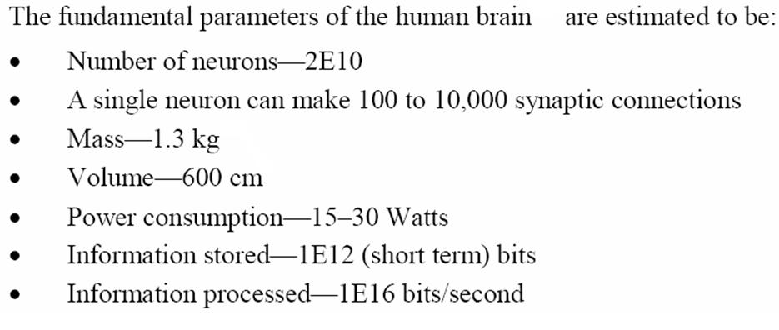
Dr. Manoranjan Kar (mano@iitp.ac.in), Indian Institute of Technology Patna, www.iitp.ac.in
Self Cleaning and Natural Colour
WHAT DO YOU MEAN BY MEMORY??
Will these devices make it? The answer is a very definite…..
Maybe!!

Slide 35
I would like to describe a field, in which little has been done, but in which an enormous amount can be done in principle. This field is not quite the same as the others in that it will not tell us much of fundamental physics (in the sense of , what are the strange particle?) but it is more like solid state physics in the sense that it might tell us much of great interest about the strange phenomena that occur in complex situations. Further more, a point that is most important is that it would have an enormous number of technical applications. What I want to talk about is the problem of manipulating and controlling things on a small scale.
Richard Feynman, Caltech, 1959
“There’s Plenty of Room at the Bottom”
1974-> Norio Taniguchi, 1981 -> Drexler -> Engines of creation

Slide 36
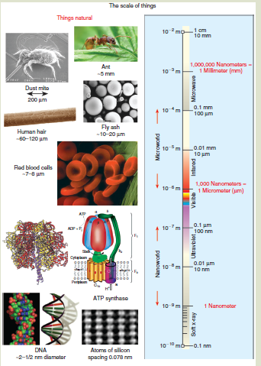
The scale of natural things compared to the electromagnetic spectrum are shown in (a), and
in (b), synthetic materials of diminishing size are depicted.

Slide 37

Can you figure out what characteristics of the
butterfly Morpho peleides limpida makes them interesting to nanoscience?
The blue color is due to Nature’s remarkable nanotechnology— the blue color is known as “structural color” (i.e. no pigment) that originates from the nanostructure in the dorsal wing. The structure interferes with certain wavelengths of light to produce an beautiful iridescent blue.
The underside of the wing , on the other hand is brown.
Why?

Slide 38
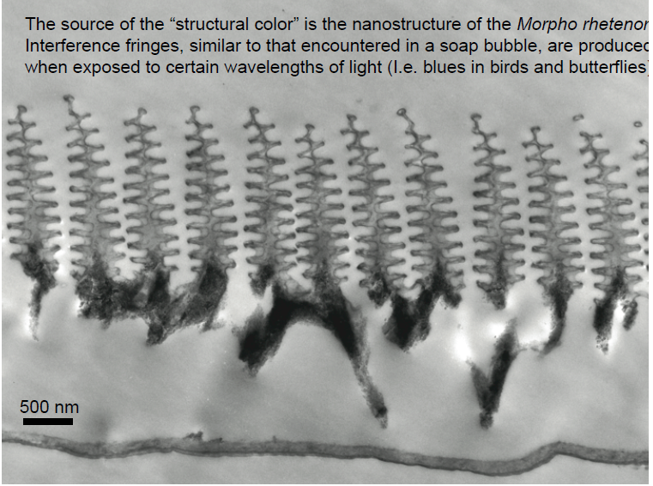

Slide 39
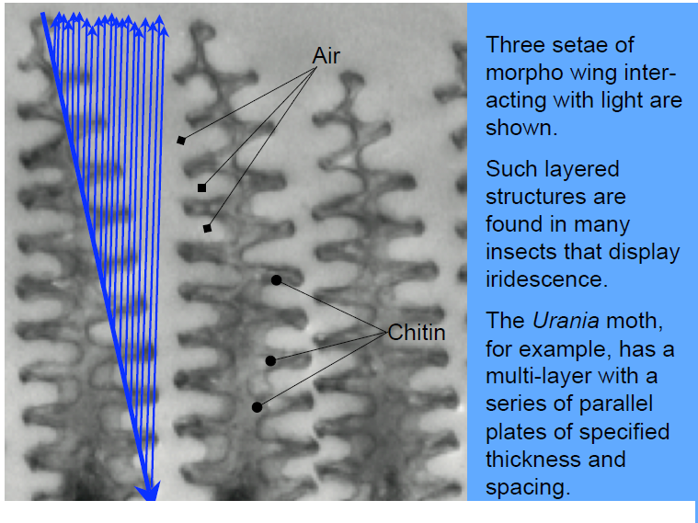

Slide 40
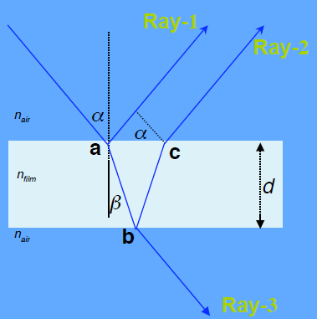
THIN FILM INTERFERENCE
n_{air} < n _{film}
Reflection from a medium
of lower refractive index: Phase Change = 0
Constructive Interference
2n_{f} d cosβ = (m + ½)λ
m = 0,1,2,3....
Destructive Interference
2n_{f} d cosβ = mλ
m = 0,1,2,3....
CONSTRUCTIVE INTERFERENCE
First, Ray-1 encounters top surface at a with n_{film} > n_{air} and there is a φ = 180° phase shift (0.5 λ) in the reflected ray
• Ray-2, is refracted and reflected at the bottom surface at b and exits at c without phase change (n_{air} < n_{film}), φ = 0°
• Ray-1 and Ray-2 differ in phase by 180° or λ/2. For constructive interference, the path length (~2d) must cause additional phase differences of wavelengths times 0.5, 1.5, 2.5…. x.
If λ is normal or very small (α,β ≈ 0°), then Ray-2 travels a distance 2d more than Ray-1. In order to see interference, 2d must contain an integral number m of wavelengths where m = 0,1,2,3

Slide 41
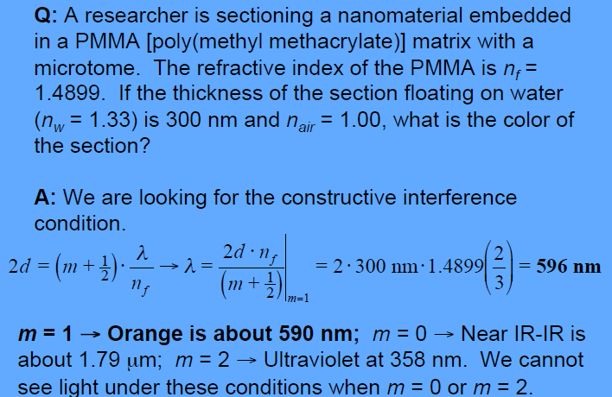
Destructive Interference
• For the n_{air} < n_{f} > n_{air} system, destructive interference (dark film minima in air), the extra path length must not cause any additional phase difference at integral multiples of the wavelength m = 0,1,2,3 …

Slide 42
The interference condition in the butterfly wing is of course way more complicated. For example, due to the complexity of the structure, the wing appears blue from many different angles of viewing.
The morpho wing also interacts with
ultra-violet light!!

Slide 43
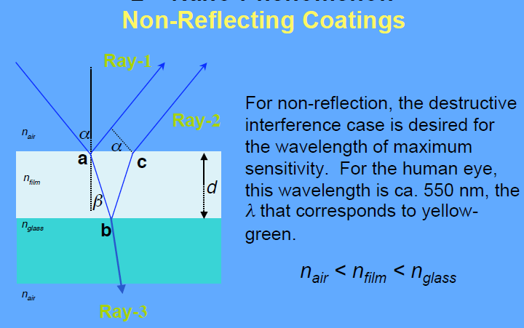

Slide 44
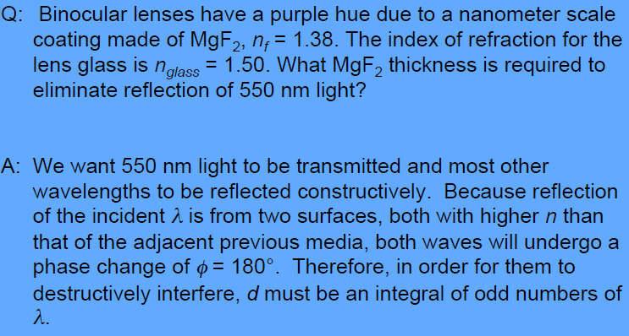

Slide 45
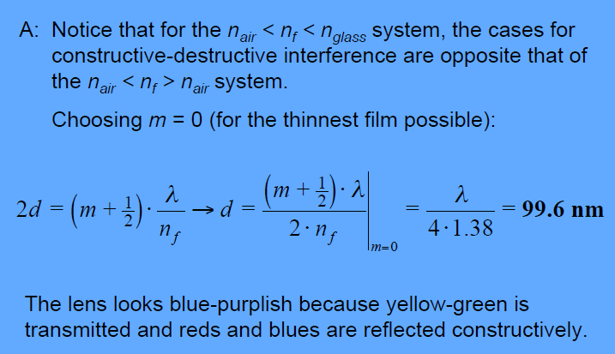

Slide 46
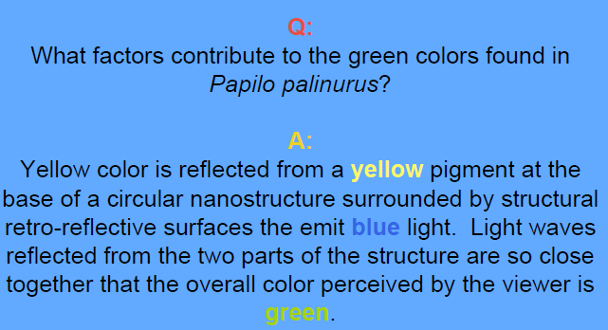

Slide 47
Review of previous classes
1. Nanotechnology in upward motion: next future of science and technology is nanotechnology
2. Constructive - Destructive interference by thin films
3. Non-Reflective Surfaces
SUPER-HYDRO-PHOBICITY, SELF-CLEANING, AND HISTROY

Slide 48
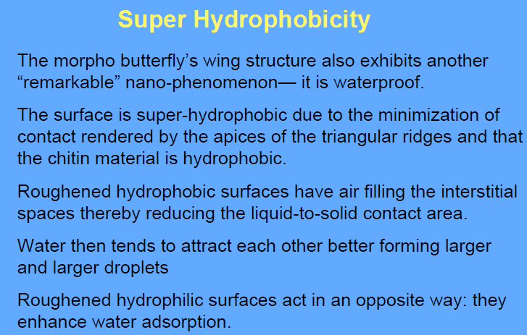

Slide 49
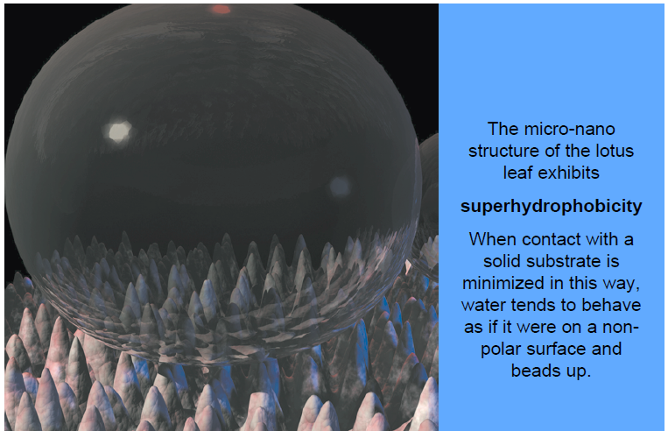

Slide 50
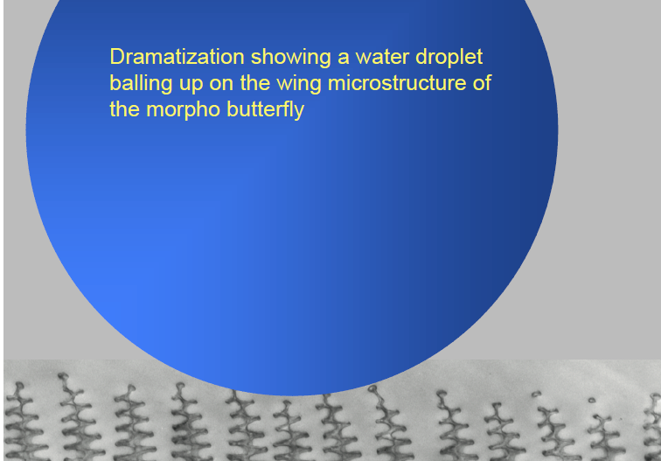

Slide 51
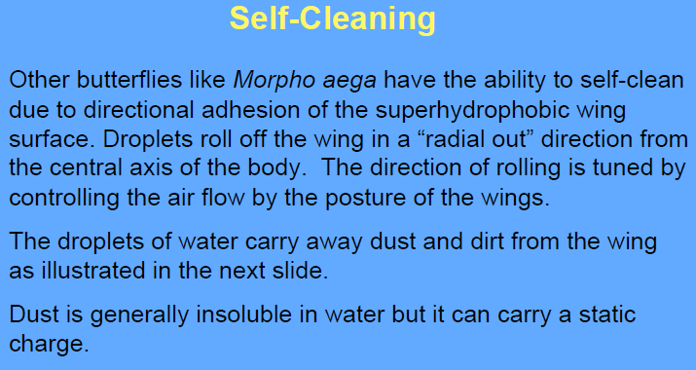

Slide 52
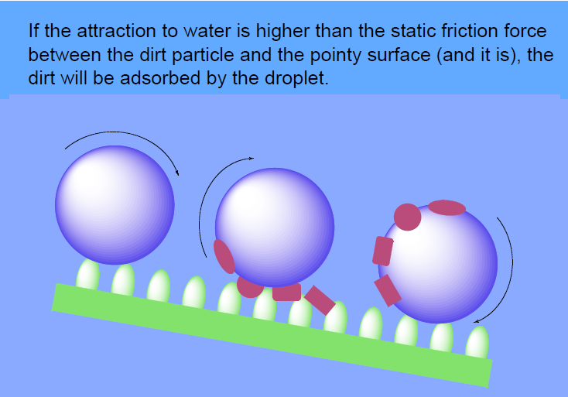

Slide 53
Nano in History
• Ochre pigments
• Maya blue
• Lycurgus Cup (gold-silver nanoparticles in NaO glass)
Rose Window of Notre Dame Paris: Eleventh Century
• Damascus sword (carbon nanotubes in steel)
• Medieval glasses (metal and semiconducting nanoparticles)
• Catalyst particles for making soap (ash, clays)
• Clay for bricks (clay is a nanomaterial!)

Slide 54
Review of previous classes
1. Nanotechnology in upward motion: next future of science and technology is nanotechnology
2. Constructive - Destructive interference by thin films
3. Non-Reflective Surfaces
4. Super-Hydro-Phobicity
5. Self-Cleaning
6. History
Why <100nm

Slide 55
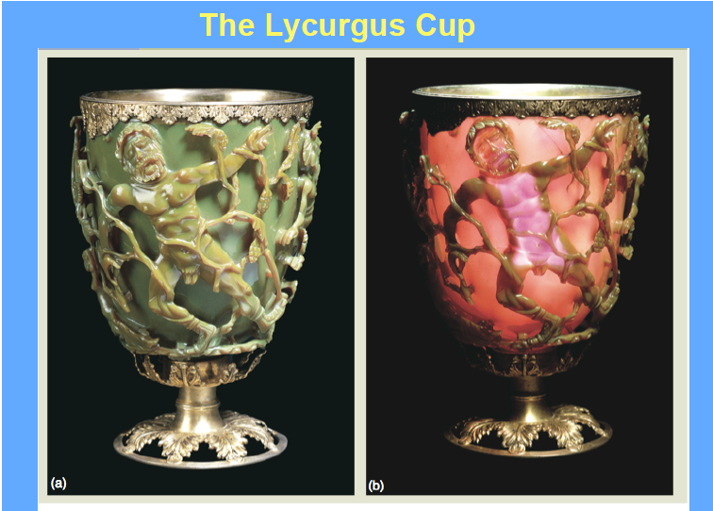
Lycurgus cup,4th century AD (now at the British Museum, London).
Depicts King Lycurgus of Thrace being dragged to the underworld
When illuminated from outside, it appears green. However, when illuminated from within the cup, it glows red.

Slide 56
The Damascus Sword
• The Damascus Sword (10th to 18th centuries) ….. a composite metal and the first technological (and unwitting) use of carbon nanotubes, other carbon materials, cementite nanowires and glasses
• The Damascus sword was strong, hard, flexible and very sharp– due to its laminar structure, the result of its special forging process
• Carbon nanotubes were formed from a special iron (steel) made in India called “Wootz steel”, a high carbon and pure steel.

Slide 57
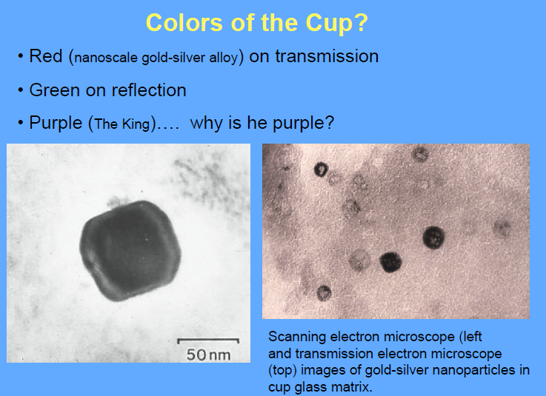

Slide 58
“Dichroism” means “two colors”. Indeed, 2 colors are revealed by the Lycurgus Cup— depending on your point of view:
1. Green on reflection, 2. Red upon transmission
Particulate Dichroism
THERE ARE SEVERAL REASONS FOR THE APPARENT
DICHROISM:
1. Metal particle size range from 40 nm to 100 nm
2. Contributions of gold / silver / copper particles
3. Absorption and scattering
• The larger silver nanoparticles dominate the scattering (i.e. mini-reflections) that results in the green appearance.
• The smaller gold nanoparticles are responsible for the ruby color on transmission.
• Alloys of the three metals may play a more subtle role

Slide 59
The Localized Surface Plasmon Resonance
Surface plasmons exist on all metal surfaces. They are known as a “sea of electrons” that interact (resonate) strongly with light.
• As the metal particles assume smaller dimensions, the plasmon assumes a more localized character.
• For example, gold nanorods have two absorptions: 1. along the major axis and one along its minor axis.
Depending on the size of the nanoparticle, type of metal, its shape and orientation, different colors are absorbed by the surface plasmon.

Slide 60
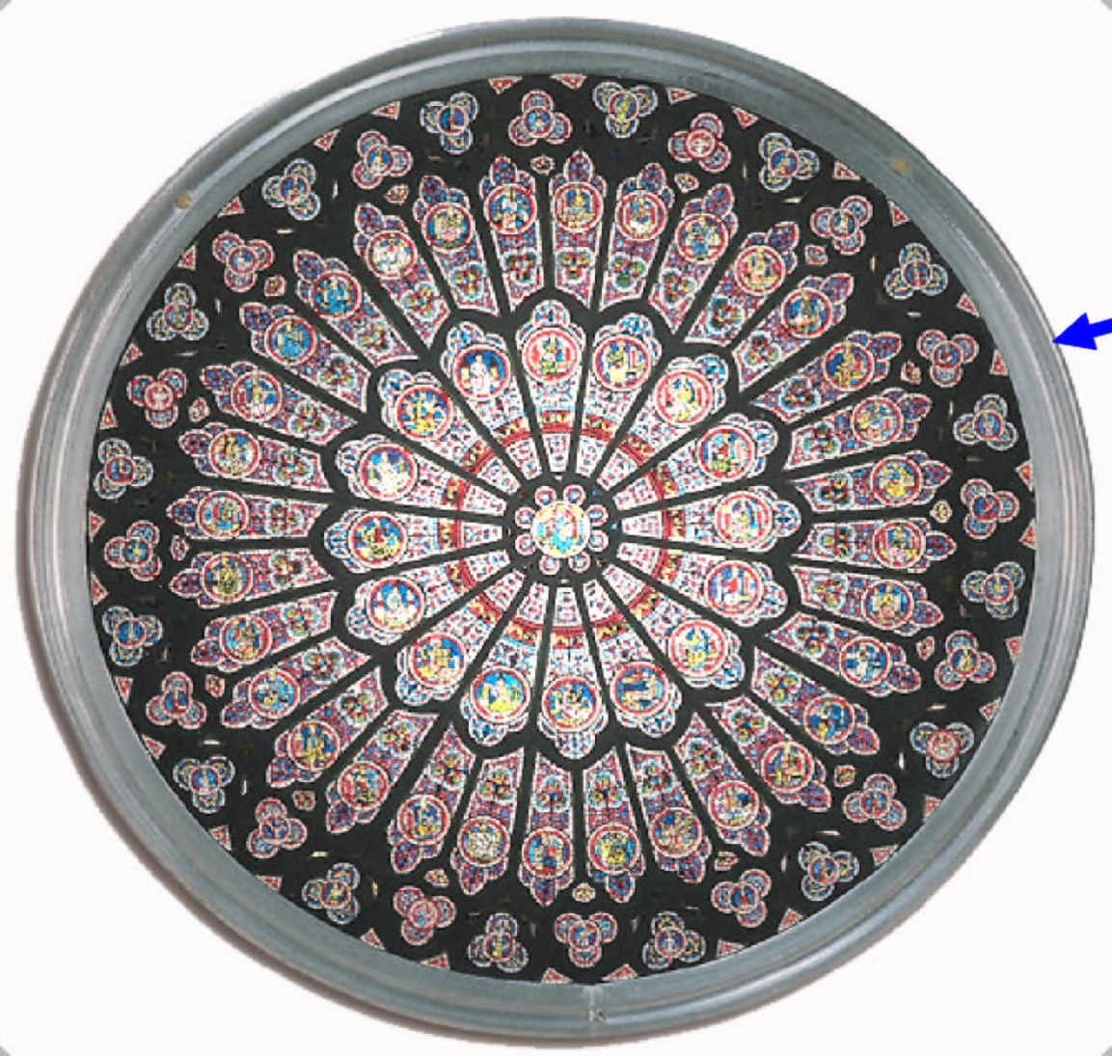
Gold Coated
Rose Window of Notre Dame Paris: Eleventh Century

Slide 61
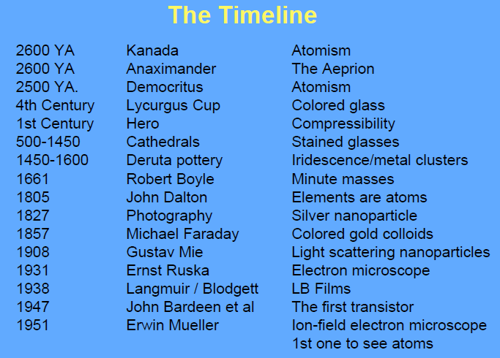

Slide 62
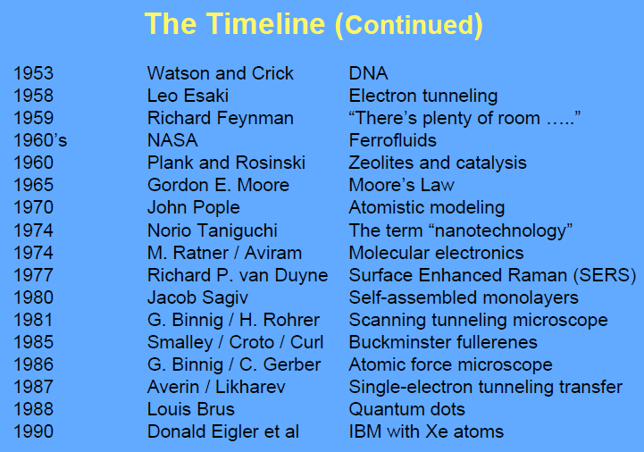
1989-> M. Eagler -> Writing by STM tool

Slide 63
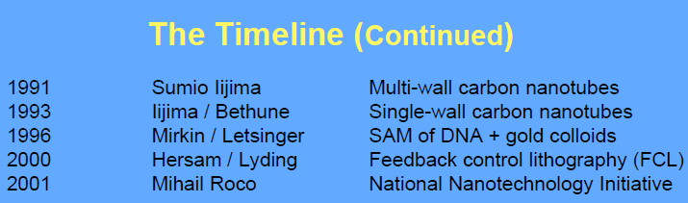
2000 Eigler et al: Construction of Quantum corrals and Quantum mirrors
2001 Florian Bamberg: Soldering of nanotubes with e-beam
2004 Intel launches the Pentium IV “Prescott” processor based technology

Slide 64
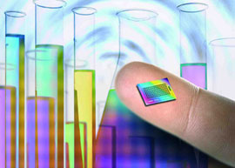




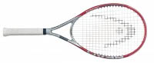
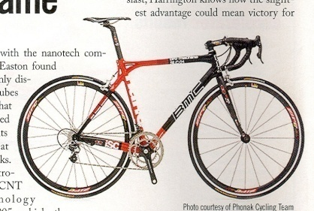





2005 onwards
Nanotechnology is already making today’s products:
Lighter
Stronger
Faster
Smaller
More Durable

Slide 65
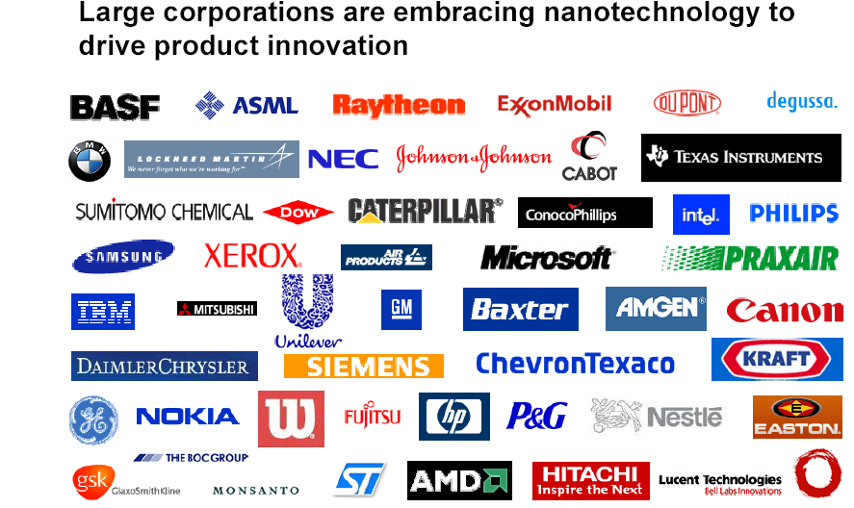

Slide 66
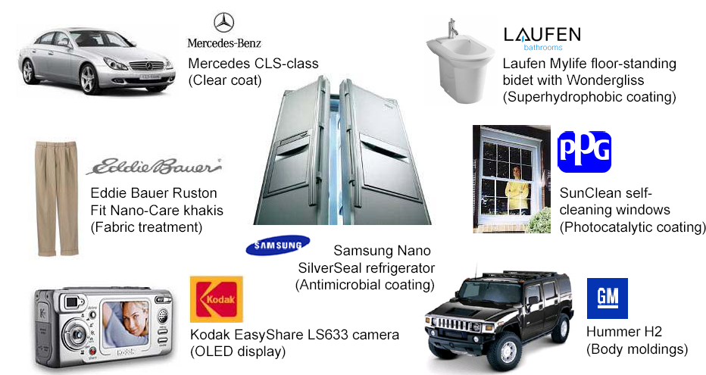

Slide 67
Coatings &
Powders
Medical
applications
Cosmetics
Paints
Drug delivery
Chemical
catalysts
Bio- materials
Coatings
Nanobio NEMS
Lubricants
Medical diagnostics
Textiles
Tissue/organ regen
Nano- arrays
A DIVERSE SET OF OPPORTUNITIES
Displays
Memory/Storage
devices
Smart implants
Food packaging
Composites
1-4
Molecular circuitry
Energy/
fuel cells
Sensors
Simple
ICs
Portable
Energy
cells
5-8
Lighting
Micro- processors
Quantum computing
Solar
cells
9-14
Energy,
Industrial
15+
Devices & Microelectronics
Years

Slide 68
Review of previous classes
1. Nanotechnology in upward motion: next future of science and technology is nanotechnology
2. Constructive - Destructive interference by thin films
3. Non-Reflective Surfaces
4. Super-Hydro-Phobicity
5. Self-Cleaning
6. History
Why <100nm

Slide 69

Dr. Manoranjan Kar (mano@iitp.ac.in), Indian Institute of Technology Patna, www.iitp.ac.in
MATERIALS
AMOURPHOUS
CRYSTALLINE
It can also be in two different form
SUPERSTRUCTURE
QUASICRYSTAL

Slide 70
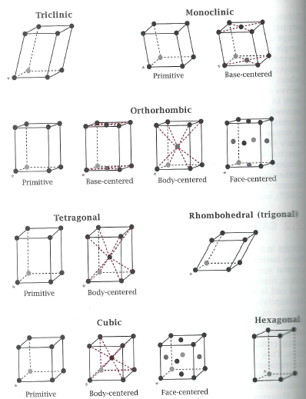
Dr. Manoranjan Kar (mano@iitp.ac.in), Indian Institute of Technology Patna, www.iitp.ac.in

Slide 71
Dr. Manoranjan Kar (mano@iitp.ac.in), Indian Institute of Technology Patna, www.iitp.ac.in
Triclinic
Monoclinic
Orthorhombic
Tetragonal
Cubic
Hexagonal
Rhombohedral
α ≠ β ≠ γ ≠ 90⁰ a ≠ b ≠ c
α (ZY) β(ZX) γ(XY)
α = γ = 90⁰ ≠ β a ≠ b ≠ c
α = β = γ= 90⁰ a ≠ b ≠ c
α = β = γ=90⁰ a = b ≠ c
α = β = γ= 90⁰ a = b = c
α = β = 90⁰ γ=120⁰ a = b = c
α = β = γ ≠ 90⁰ a = b = c
P
P, C
P, C, F, I
P, I
P, F, I
P
R
1
2
4
2
3
1
1

Slide 72
Dr. Manoranjan Kar (mano@iitp.ac.in), Indian Institute of Technology Patna, www.iitp.ac.in
Quasicrystal
Crystalline
Crystal
Crystal
Crystal
Crystal
Super structure
NANOCRYSTALS ARE SINGLE DOMAIN PARTICLES

Slide 73
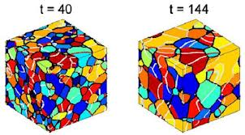
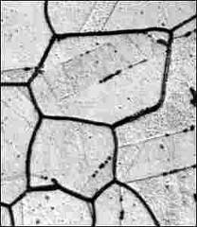
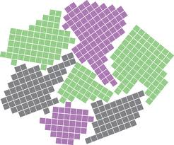
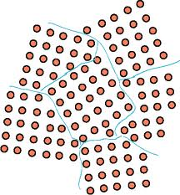
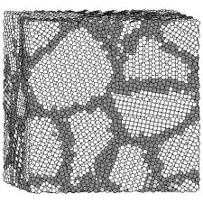
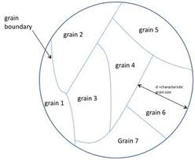
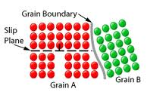
Dr. Manoranjan Kar (mano@iitp.ac.in), Indian Institute of Technology Patna, www.iitp.ac.in

Slide 74
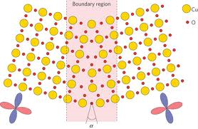
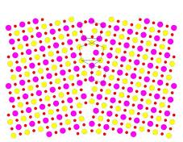

Dr. Manoranjan Kar (mano@iitp.ac.in), Indian Institute of Technology Patna, www.iitp.ac.in
~100nm or < 100nm
If Size reduce to grain boundary wall size, What happens ????
We call nanomaterial. These are single domain single crystal.
Electron confined in this size and shows single electron transition property as its wavelength and Bohr radius is comparable to size of the particle. Let us think and calculate. Definitely we will come up with our own answer. Its very interesting. We will apply our basic science knowledge, the interesting science and technology is lying there.
Low Angle (13 to 15 degree) and High angle crystallographic grain boundary

Slide 75
Review of previous classes
1. Nanotechnology in upward motion: next future of science and technology is nanotechnology
2. Constructive - Destructive interference by thin films
3. Non-Reflective Surfaces
4. Super-Hydro-Phobicity
5. Self-Cleaning
6. History
7. Why <100nm
Electron in the material at nanoscale???

Slide 76
LENGTH SCALES AND QUANTUM CONFINEMENT
de Broglie Wavelength
Bohr Radius
Excitons
Semiconductor
Metal
Quantum approach
Quantum confinement

Slide 77
De-Broglie wave length
1- Newton’s Corpuscular theory
2- Hygen-> Light is a wave
de Broglie – end this mistery- Hypothesis ? Why?
-> Wave-Particle hypothesis
h = Plank’s constant = 6.62 x 10⁻³⁴ JS
Let us calculate for a free electron travelling in vacuum: velocity = 0.01c, m = 9.1x10⁻³¹ kg
λ = 0.24nm, It is comparable to interatomic spacing of atoms (10⁻¹⁰m) in crystals
Momentum can be controlled by controlling speed
Let us calculate for Fullerene (C₆₀)-. Known as Bulky ball structure -> Also Bulk minsterfullerene
Nobel prize to Horal Kroto, Richard Smally and Robert in 1985 (Rice and Sussex university)
m_{C60} = (12.011(m.w. of C in g.)x60 (total number))/(N_{a}(avogadro number)X 1000)=1.2x10⁻²⁴kg
v =220m/s, λ _{C60} = 2.5pm
Very small, so macroscopic objects are generally not as significant as their particle – like properties.
Try to calculate wave length of yours by traveling 40km/h (maximum speed of human being)

Slide 78
Now we will calculate de-Broglie wave length of electron and hole in a semiconductor
Electron: m_{eff} (e)= effective mass of electron inside semiconductor (Its mass modified due to bound in nature) = 0.1m₀ (rest mass of free electron)
v_{e}= changes due to again bound and face havy potential = 10⁵m/s
So, λ_{e} (in semiconductor) = h/mv ~73nm
Hole: m_{eff} (h)= effective mass of hole inside semiconductor (Its mass modified due to bound in nature) = 0.4m₀ (holes are more bound as in valence band)
v_{h}= changes due to again bound and face havy potential = 10⁵m/s
So, λ_{h} (in semiconductor) = h/mv ~18.2nm

Slide 79
III-IV | m_{e}(m₀) | m_{h}(m₀)
AlAs | 0.150 | 0.5
GaAs | 0.067 | 0.5
GaSb | 0.041 | 0.28
InP | 0.077 | 0.6
InAs | 0.022 | 0.4
InSb | 0.014 | 0.4
II-VI
CdS | 0.2 | 0.7
CdSe | 0.13 | 0.45
CdTe | 0.11 | 0.35
HgTe | 0.029 | 0.3
IV-VI
PbS | 0.1 | 0.1
PbSe | 0.07 | 0.06
We will see it later in assignment

Slide 80
Review of previous classes
1. Nanotechnology in upward motion: next future of science and technology is nanotechnology
2. Constructive - Destructive interference by thin films
3. Non-Reflective Surfaces
4. Super-Hydro-Phobicity
5. Self-Cleaning
6. History
7. Why <100nm
8. Magic Number
9- Confinement in Semiconductor
10-Magnetic nanoparticles
Why Surface to Volume Ratio
Magic Number

Slide 81
BOHR RADIUS
student can refer to any standard book
Calculate for the electron and hole in semiconductor….
One can feel the length. Also calculate corresponding wave length
2πr = nλ
For example λ_{e} = 0.528x2x3.14Å

Slide 82
EXCITON
Excitons are coulombically bound electron-hole pairs. They form upon the absorption of light, which promotes an electron from the semiconductors valence band into its conduction band .
Mott- Wannier -> Weaker coulomb interaction . Binding energy of electron – hole pair is less ~ 10meV
Frenkel Exciton -> Stronger coulomb interactions. Corresponding binding energies are of the order of 100meV
The exciton formation energy is E_{x}=E_{g}-E_{bin}. E_{bin} –Exciton binding energy and E_{g} – Semiconductor band gap.
Mott – Wannier exciton are not stable at room temperature as thermal energy at room temperature K_{B}T ~25meV. It is stable where K_{B}T ~1meV
In nanostructure -> Situation different as they stay close to each other.
(Semiconductor : Mott-Wannier Excitons, ε ~ 10, Organic where, ε ~ 2 )

Slide 83
Bulk Exciton Bohr Radius
So Bohr radius depends upon dielectric constant of semiconductor. It depends upon frequency. Let us take optical range
EXAMPLE
CdSe: ε_{optical} ~ 9.7, me = 0.13m₀, m_{h} = 0.45m_{o},μ=9.2x10⁻³²kg, a_{B}=5.07nm
ZnO: ε_{optical} ~ 3.7, me = 0.24m₀, m_{h} = 0.45m_{o},μ=1.4x10⁻³²kg, a_{B}=1.24nm

Slide 84



CONFINEMENT REGIM
Weak Confinement: λ> λ_{e}, λ _{h}.
Intermediate Confinement: λ _{h}< λ < λ _{e}.
Strong Confinement: λ < λ _{e}, λ _{h}.

Slide 85

METALS
Even at size 2nm, most of the metals show bulk like property. So difficult to define length scale
λ_{F}-Fermiwavelength-Carrier confinement-identical to de-Broglie wavelength
d_{charging}->Associated with electrical property of small metal nanostructure. Namely this is a size below which the coulomb charging energy of such structures becomes significant
d_{mean}->Mean free path of electron

Slide 86
 | n (X10²⁹) | Fermi energy | Fermi Velocity (x10⁶) | Fermi Wave length (nm
Gold | 5.9 | 5.52 | 1.39 | 0.52
Silver | 5.86 | 5.50 | 1.39 | 0.52
Copper | 8.49 | 7.03 | 1.57 | 0.46
Aluminum | 18.1 | 11.65 | 2.02 | 0.36
Kudo Gap : Energy spacing between levels of small metal nanostructures
Mean free Path: Calculate for copper ~5.69x10⁻⁸m=56.9nm
Drude-Lorentz Theory: Interaction of light and free electron

Slide 87

Charging energy is significant at nanoscale in case of metal sphere.
Structure | Degree of Confinement | Degree of Freedom | Nomencluture
Bulk | 0 | 3 | Bulk materials
Quantum well | 1 | 2 | 2D system
Nanowire | 2 | 1 | 1D system
Quantum Dot | 3 | 0 | 0D system

Slide 88
Review of previous classes
1. Nanotechnology in upward motion: next future of science and technology is nanotechnology
2. Constructive - Destructive interference by thin films
3. Non-Reflective Surfaces
4. Super-Hydro-Phobicity
5. Self-Cleaning
6. History
7. Why <100nm
8. Magic Number
9- Confinement in Semiconductor
10-Magnetic nanoparticles
Why Surface to Volume Ratio
Magic Number

Slide 89

HYSTERESIS
HARD MAGNETS - H_{c} > 100 Oe (MOTORS, GENERATORS),
SOFT MAGENTS - H_{c} < 10 Oe (TRANSFORMER CORES, ELECTRONIC CIRCUITS)

Slide 90

The initial magnetization curve may be divided into two regimes:
(i) Rayleigh law regime and (ii) Magnetization rotation
The low-field behavior of the initial magnetization is given by the Rayleigh law,
µ = µ_{o} + νΗ (B = µH)
where µ_{o} and ν are the Rayleigh constants of the material:
30 < µ_{o} < 10⁵ , 0.5 < ν < 1.2 x 10⁷ and B = µ_{o}H + νH²
Hence the parabolic nature of M vs. H at low H.

Slide 91

MAGNETIC DOMAINS
An ordinary piece of iron below its curie temperature shows spontaneous magnetization called micromagnetics.
A macroscopic magnetic material will break up into magnetic domains to minimize the energy.

Slide 92


Slide 93

Schematic of ferromagnetic material containing a 180º domain wall (center). Left, hypothetical wall structure if spins reverse direction over one atomic distance. Right for over N atomic distance, a. In real materials, N: 40 to 10⁴.

Slide 94

magnified sketch of the spin orientation within
a 180º Bloch wall in a uniaxial materials; (b) an appro-
ximation of the variation of θ with distance z through
the wall.

Slide 95


Magnetic Domain and Domain Walls
1. Domain walls
Bloch wall, Néel wall, Cross-Tie wall
The boundary between two magnetic domains in a thin film in which the magnetization vector remains parallel to the faces of the film in passing through the wall.
Cross-tie domain wall is a complex two dimensional magnetic domain wall structure, often found experimentally in thin soft ferromagnetic films with thicknesses of about several exchange lengths. The structure of such a wall can roughly be imagined as a sequence of magnetic vortices and anti-vortices, arranged along a straight line. 2. Magnetic domains
Uniaxial wall spacing , Closure domain
Stripe domains, Head to Head (Votex), Domain in
antiferromagnetic films
3. Single domain and super-paramagnetism
4. Some methods for the domain observation
SEMPA, MFM, Magneto-optical

Slide 96
The critical size below which particle exists as a single domain is given as
SW model is based on certain assumptions such as, (i) within a single domain all the spins are collinear and rotation of spins takes place coherently and collectively and (ii) interaction between the particles is negligible. In this model, the calculation were made for elongated ellipsoidal particles, because the ellipsoidal shape includes all the particle shape of physical interest, such as rod, sphere and disk.
Total anisotropy energy (alignment energy) of a particle is given as
The first term in the equation is anisotropy energy and second term is additional potential energy supplied by the field to the single domain particle

Slide 97

The magnetic coercivity of a magnetic nanoparticle depends significantly on their magneto-crystalline anisotropy, micro-strain, inter-particle interaction, temperature, shape and size.
In the multi domain structure, magnetization reversal occurs through a domain wall motion and the size variation coercivity is given as
At a critical size, particles become single domain where the change of direction of magnetization can occur only by coherent rotation of spins which requires high magnetic field. As an effect, it results in considerably high coercivity. Coercivity is found to be increased with the particle size within a single domain. It is because of the progressively increasing role of thermal fluctuations. Here size dependence of coercivity can be expressed as,

Slide 98
Review of previous classes
1. Nanotechnology in upward motion: next future of science and technology is nanotechnology
2. Constructive - Destructive interference by thin films
3. Non-Reflective Surfaces
4. Super-Hydro-Phobicity
5. Self-Cleaning
6. History
7. Why <100nm
8. Magic Number
9- Confinement in Semiconductor
10-Magnetic nanoparticles
Why Surface to Volume Ratio
Magic Number

Slide 99


DEFECTS
Point Defects (Scottkey defects, Frenkel defects)
Linear Defects (Edge dislocations)
Planer Defects (Interfacial defects, Grain boundary, Interphase boundary)
Volume defects
Casting defects (Cavities and gas holes)
MECHANICAL BEHAVIOUR

Slide 100




Point of action

Slide 101
SURFACE TO VOLUME RATIO
Volume α L³ and Surface α L²
Surface to Volume Ratio α L⁻¹
PLANE
Square Slab: Thickness = a, Side = L
L » a ; So effective surface area=2L² and Volume L²a
Surface to Volume Ratio; R_{plane} = (2/a)
Cylinder with length = L and radius = a
Effective surface area = 2πaL and Volume = πa²L
Surface to Volume Ratio; R_{cylinder} = (2/a)
CYLINDER
Cube of side = a
Effective surface area = 6a² and Volume = a³
Surface to Volume Ratio; R_{cylinder} = (6/a)
CUBE
SPHERE
Radius = a
Effective surface area = 4πa² and Volume = (4/3)πa³
Surface to Volume Ratio; R_{Sphere} = (3/a)

Slide 102

There are different ways to calculate the number of atoms in a nanostructure
1- Unit Cell Approach
2- Bulk Density Approach

Slide 103
Review of previous classes
1. Nanotechnology in upward motion: next future of science and technology is nanotechnology
2. Constructive - Destructive interference by thin films
3. Non-Reflective Surfaces
4. Super-Hydro-Phobicity
5. Self-Cleaning
6. History
7. Why <100nm
8. Magic Number
9- Confinement in Semiconductor
10-Magnetic nanoparticles
Why Surface to Volume Ratio
Magic Number-Unit cell approach

Slide 104


FCC structure
Group A: For n = 3, there are four atoms shown on the diagram (corner)
each is shared among three adjacent faces (4/3)
Now multiply by six faces = 8 atoms (cube has eight corners so in general
there are 8 atoms in group A)
Group B: Eight atoms (edge). Each is shared among two faces; 4x six faces = 24 atoms. (cube has twelve edges, with two atoms on each edge in this case).
Note that the atoms are located on the intersection between the blue lines and the edges. Each edge has n-1 blue lines. Multiply by the number of edges to obtain 12(n-1).

Slide 105
Y
FCC structure
z
Group C: Nine atoms: They are not on corners or edges, so there is no sharing factor by which to divide. Six faces make 54 total atoms.
Number of atoms on each face is n², making 6n² total.
Group D: Four atoms on the face, no sharing, so there are 24 atoms.
Note that they are all located on the intersections of blue lines.
There are n-1 blue lines in both the horizontal and vertical directions, so there must be (n-1)² intersections. Total for group D: 6(n-1)².
8+12(n-1)+6n²+6(n-1)²
12n² + 2 atoms on the surface.

Slide 106

FCC structure
No interior points for z = 0 and 3
Group A: Nine atoms in one layer : Two layers: Total 18 atoms.
Note: Each atom is in the center of the small square representing the unit cell, making n² per layer. There are n-1 layers. This gives a total of n²(n-1) atoms in Group A.
Group B: These are found on the intersections of the blue lines. This situation was encountered previously when counting group D of the surface atoms; there are (n-1)² of them per layer here. There are n-1 layers, so the total is (n-1)(n-1)(n-1).
Group C: There are twelve shown per layer. To extend this to the general case, notice that they are found on the blue lines, but not at the intersections. Each blue line has n of them, and there are 2(n-1) blue lines total. This makes 2(n-1)n atoms per layer.
2(n-1)nxn=2(n-1)n² atoms in group C.
Total atoms =4n³-6n²+3n-1 (interior atoms)

Slide 107



UNIT CELL APPROACH
Smallest Cubo - Octahedral

Slide 108

6n² + 2 atoms on the surface.
Total atoms =2n³-3n²+3n-1 (interior atoms)

Slide 109


Slide 110


Slide 111


Slide 112


Slide 113


Smallest Cubo - Octahedral

Slide 114


Slide 115
Percent Surface Atoms of Cubohedral Magic Clusters
K | M | N | N/M
1 | 1 | 1 | 1.00
2 | 13 | 12 | 0.92
3 | 55 | 42 | 0.76
4 | 147 | 92 | 0.62
5 | 309 | 162 | 0.52
6 | 561 | 252 | 0.45
7 | 923 | 362 | 0.39
8 | 1415 | 492 | 0.35
9 | 2057 | 642 | 0.31
10 | 2869 | 812 | 0.28
50 | 4.04e+5 | 2.4e+4 | 0.06
100 | 3.28e+6 | 9.8e+4 | 0.03

Slide 116


Size depended Properties
• Surface to volume ratio:-A 3 nm iron particle has 50% atoms on the surface
- A 10 nm particle 20% on the surface
- A 30 nm particle only 5% on the surface
• Spherical iron nanocrystals
• J. Phys. Chem. 1996, Vol. 100, p. 12142

